Slide 1
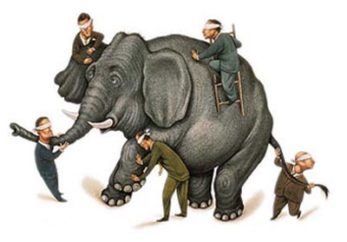

Slide 2
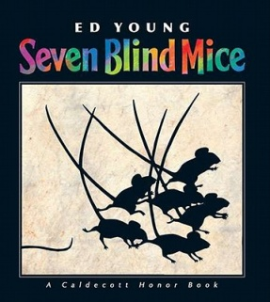
I can compare the experiences of characters in stories.
1 2 3 4

Slide 3
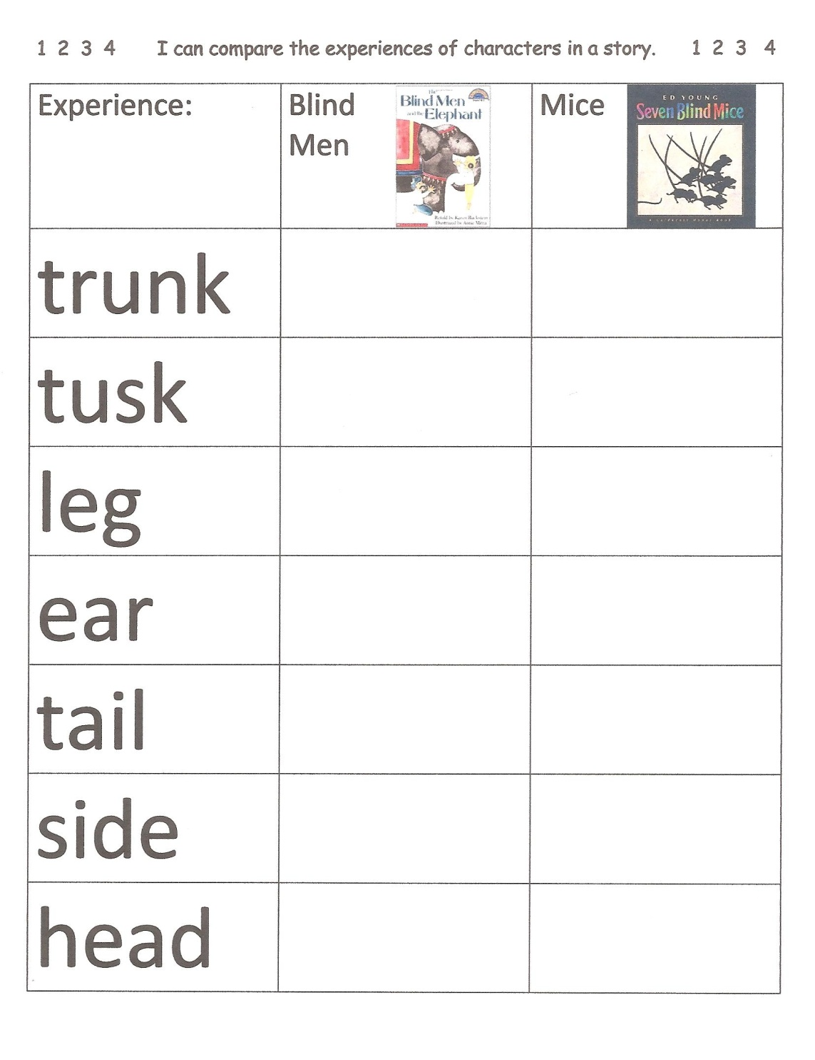
Comparing
I find the items to compare.
I choose the features to compare.

Slide 4
Comparing
I find the items to compare.
I choose the features to compare.
I tell how they items are the same or different.

Slide 5
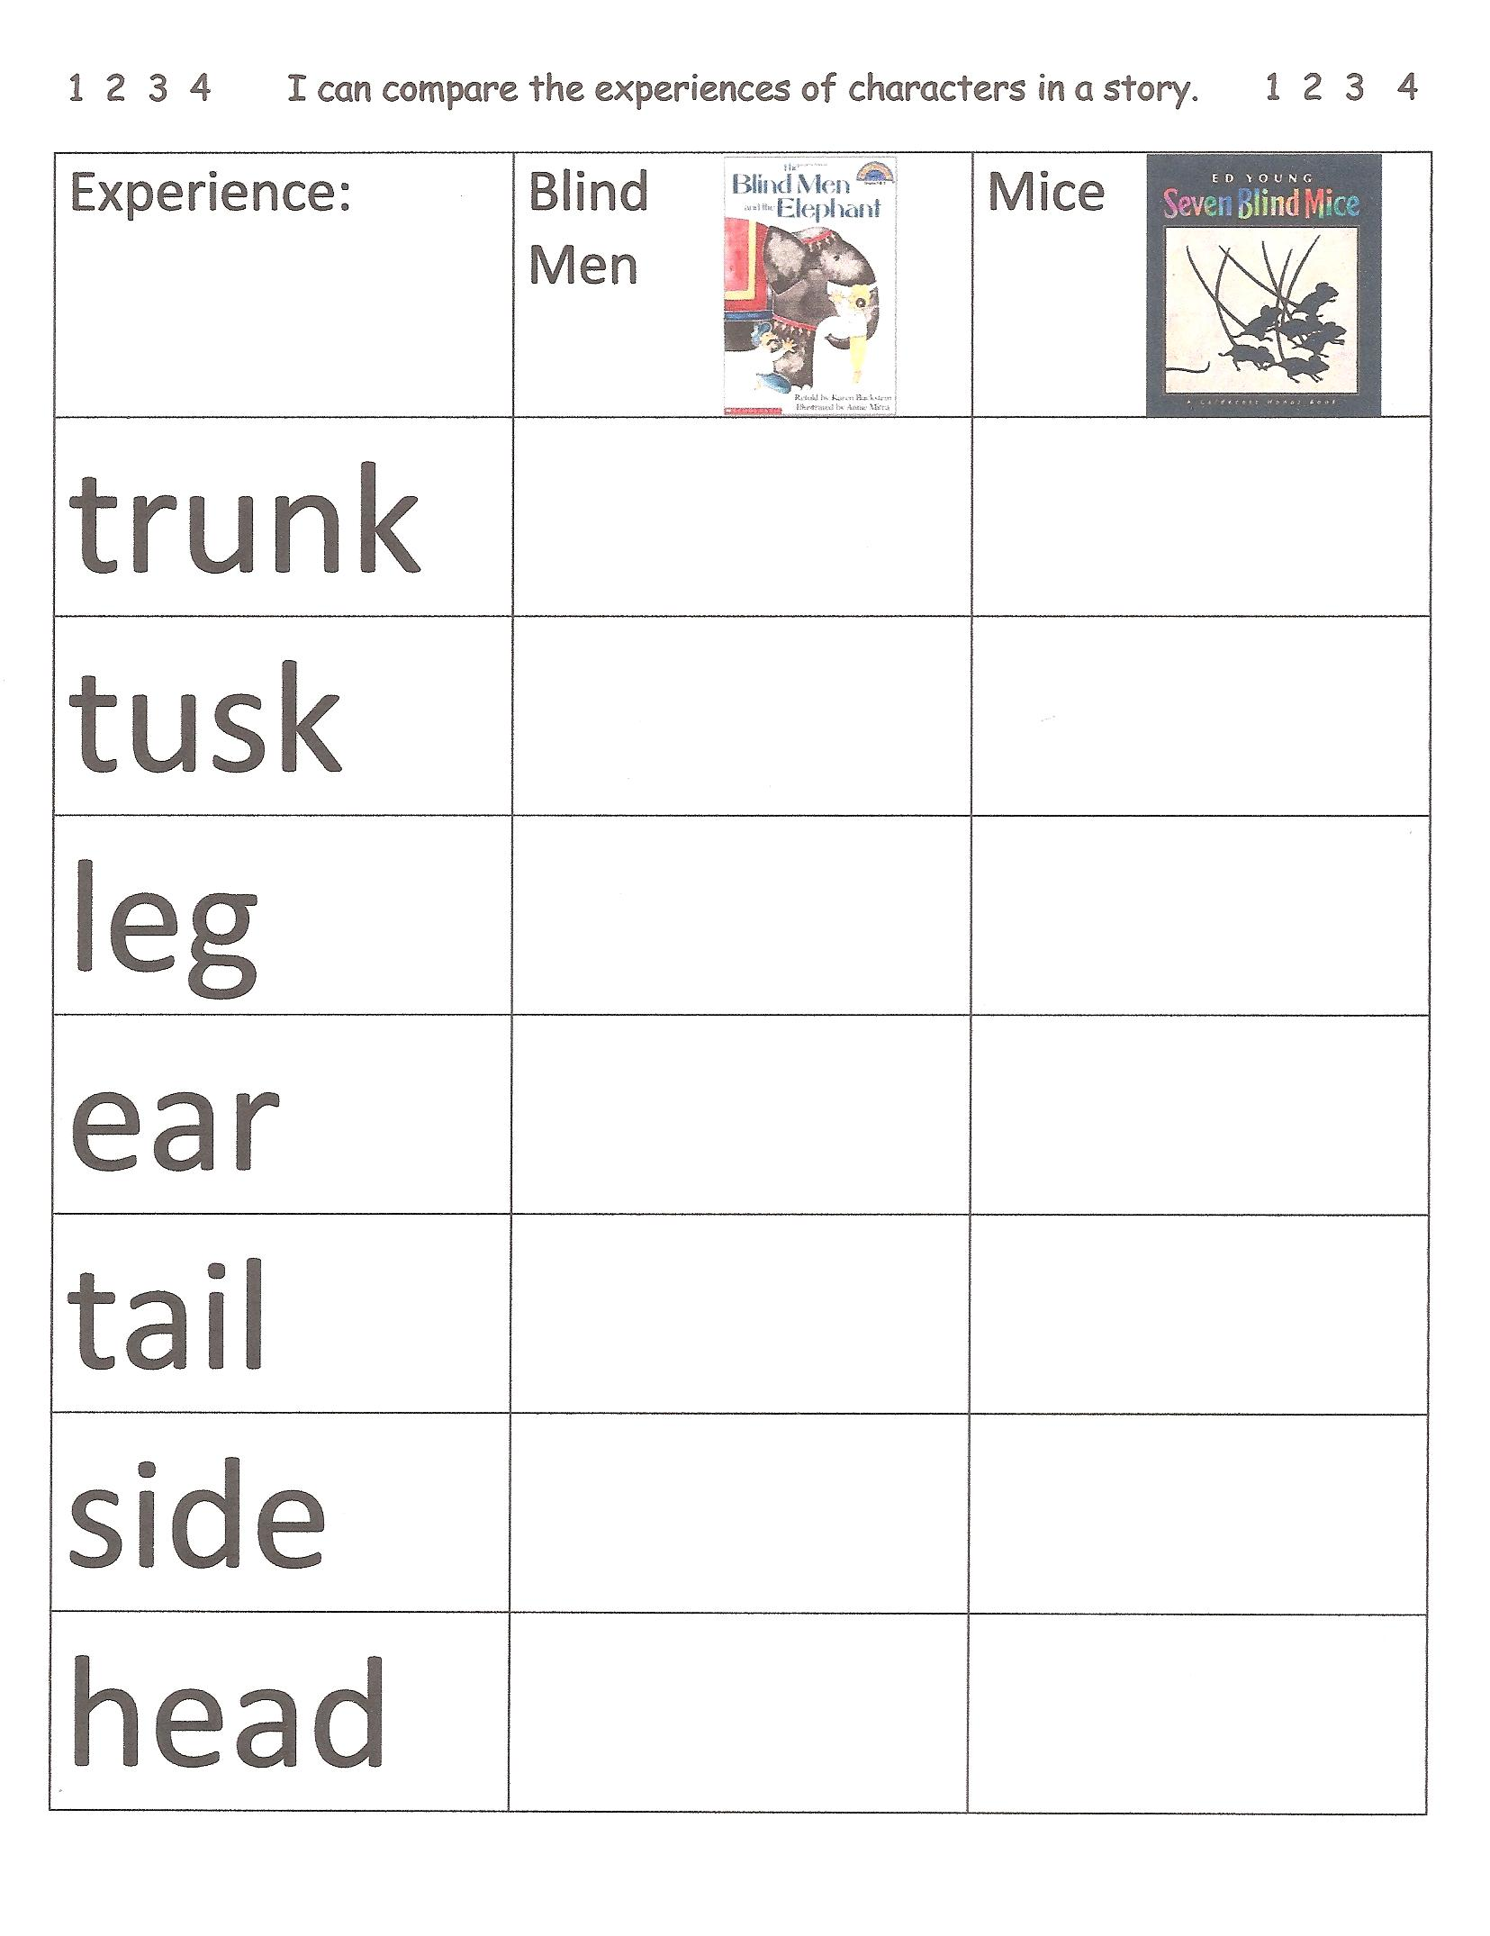

Slide 6
I can compare the experiences of characters in a story.
1 2 3 4

